Slide 1
Presentation on
ONLINE EXAMAMINATION SYSTEM
Presented by
SUBHANKAR MANDAL
KUNTAL CHOUDHURY
DIBYENDU RANA
MANISH GHOSH
SUMAN DEY
Guided by
Prof. Sandipan chakravorty
Dept. of Computer Science of Engineering
THE NEOTIA UNIVERSITY, WEST BENGAL, INDIA
June, 2020
1
THE NEOTIA UNIVERSITY, WEST BENGAL, INDIA

Slide 2

content
Introduction 10.System Analysis
Why online examination 11. System Design
Literature survey 12. Advantages
Modules 13.Disadvantages
Problem Definition 14. Existing System
Problem Statement 15. Expected Result
Proposed System 16. Future Scope
Software Requirement 17. Conclusion
Hardware Requirement 18. Reference
THE NEOTIA UNIVERSITY, WEST BENGAL, INDIA
2

Slide 3

Introduction
Online Exams is being launched because a need for a destination that is beneficial for both institutes and students. With this site, institutes can register and host online exams. Students can give exams and view their results. This site is an attempt to remove the existing flaws in the manual system of conducting exams.
Purpose
Online Exams System fulfills the requirements of the institutes to conduct the exams online. They do not have to go to any software developer to make a separate site for being able to conduct exams online. They just have to register on the site and enter the exam details and the lists of the students which can appear in the exam. Students can give exam without the need of going to any physical destination. They can view the result at the same time. Thus the purpose of the site is to provide a system that saves the efforts and time of both the institutes and the students.
THE NEOTIA UNIVERSITY, WEST BENGAL, INDIA
3

Slide 4

Why online Examination
Stored Repository of exams
Auto grading
Flexible
Time Saver
Security
General problem with time for students
Develop a system which allows the faculty to create, modify and store questions which can be grouped together to form sections and these sections can be grouped together to form/ examinations.
THE NEOTIA UNIVERSITY, WEST BENGAL, INDIA
4

Slide 5
Problem Definition
The need to have online examination systems have been strongly felt in the last 2-3 years than ever before. Keeping the above statement in mind, we have felt an urge to do away with the existing manual system and convert the same into online examination system. It goes without saying that in an online system, security aspects are as important as it is to provide easy to navigate multiple choice-based response systems to accomplish online examination system. The project is an attempt to overhaul the existing manual system and convert the same into an online system, that’ll enable users to …
View the exam types via the exam catalog
Register on site
Login to appear for exam
View sample question paper
Appear for exam
We have primarily identified two categories of users
The Administrator: One who can add/ update/ delete exams
b) The user: The exam taker
THE NEOTIA UNIVERSITY, WEST BENGAL, INDIA
5

Slide 6

Proposed System
In comparison to the present system the proposed system will be less time consuming and is more efficient.
Result will be very precise and accurate and will be declared in very short span of time because calculation and evaluations are done by the simulator itself.
The proposed system is very secure as no chances of leakage of question paper as it is dependent on the administrator only.
The logs of appeared candidates and their marks are stored and can be backup for future use.
THE NEOTIA UNIVERSITY, WEST BENGAL, INDIA
6

Slide 7

Software Requirement
Operating System
Windows XP and others
Front End
JSP (Java Server Pages)
HTML (Hypertext Markup Language)
CSS (Cascading Style sheet)
Back End
Oracle DBMS
JDK (Java Development Kit)
Browser
Internet Explorer and others
THE NEOTIA UNIVERSITY, WEST BENGAL, INDIA
7

Slide 8
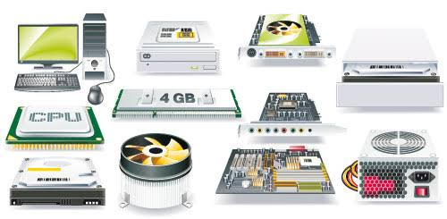
Hardware Requirement
Client side | Server Side
Browser Any Browser | Processor Pentium 2.0 and above
Processor Pentium 2.0 and above | RAM 1 GB
RAM 256 MB | Hard Disk Space 4 GB
THE NEOTIA UNIVERSITY, WEST BENGAL, INDIA
8

Slide 9
Technology used
Tier 1
HTML
CSS
Bootstrap
JavaScript
Tier 2 (Application Layer):
apache tomcat server, j2ee- servlet , jsp*Use of maeven as a built tool
Primary Logic: CRUD operations using MVC
Secondary Logic:
Authentication Logic
Transaction Logic
Technology to be used:
Core Java
Advanced Java
Servlets
JSP
Tier 3 (Database Layer): (Completed)
Data Model
Database Tables
Data Connection Logic
THE NEOTIA UNIVERSITY, WEST BENGAL, INDIA
9

Slide 10
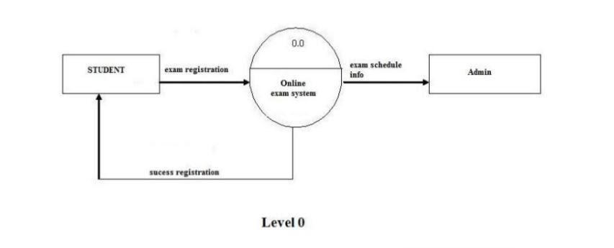
System Analysis
A DFD can be categorized in the following forms:
Context diagram: An overview of an organizational system that shows the system boundaries, external entities that interact with the system and the major information flows between the entities and the system. In this diagram, a single process represents the whole system.
First level DFD: A data flow diagram that represents a system’s major processes, data flows, and data stores at a high level of detail. Draw the DFDs upto 2nd level for Online Examination system.
Figure:- Level 0
THE NEOTIA UNIVERSITY, WEST BENGAL, INDIA
10

Slide 11
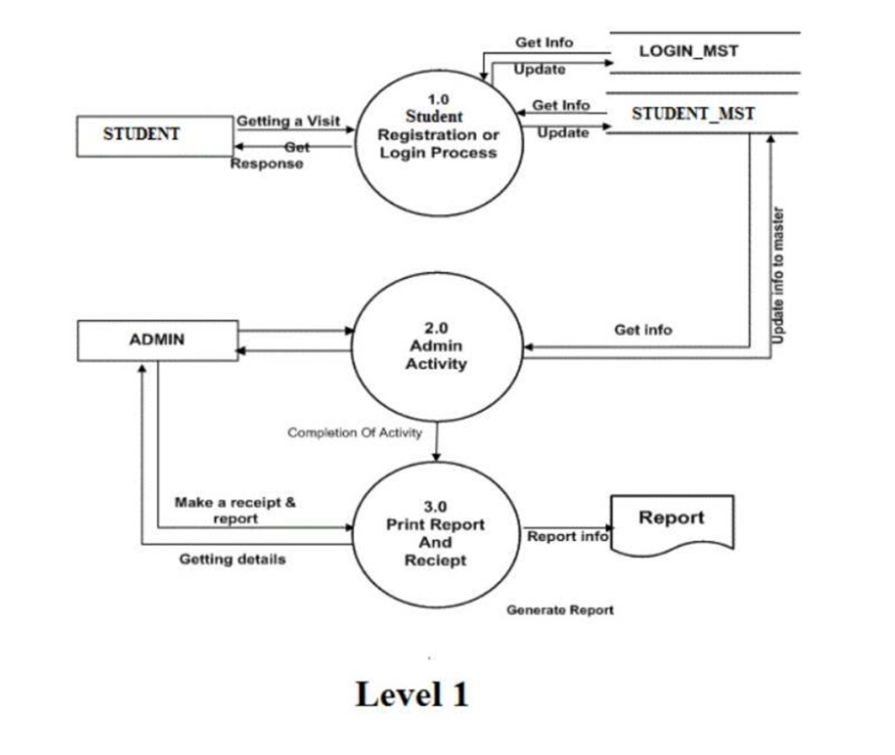
System Analysis
Figure:- Level 1
THE NEOTIA UNIVERSITY, WEST BENGAL, INDIA
11

Slide 12
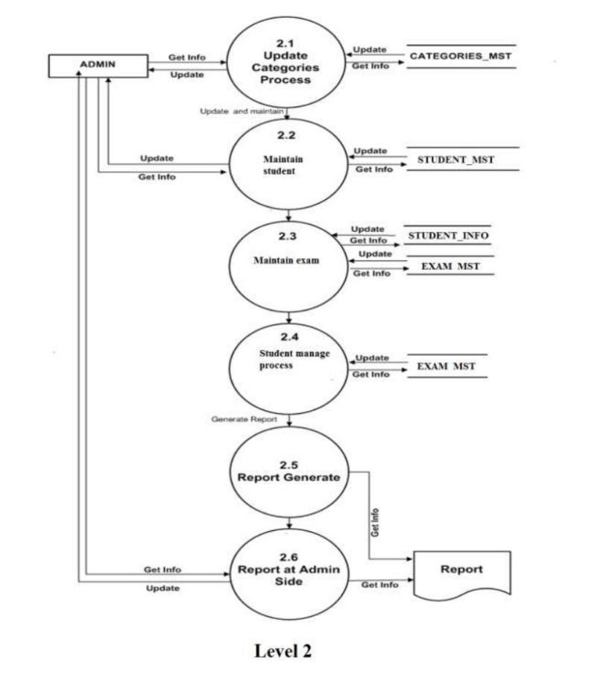
System Analysis
Figure:- Level 2
THE NEOTIA UNIVERSITY, WEST BENGAL, INDIA
12

Slide 13
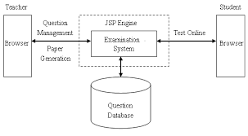
System Design
The goal of this phase is to convert the requirements into a structure that is suitable for implementation in some programming language.
The online examination system uses client/ server architecture. At the client by using a web browser can connect via internet or local host with the server where JSP and Oracle DBMS in the server side are responsible for the preparing exams processes and save and return data from database.
THE NEOTIA UNIVERSITY, WEST BENGAL, INDIA
13

Slide 14

Advantages of online Examination
Physical pressure at a given location is absolutely not necessary.
Result available instantly.
Easy Accessibility.
User Friendly.
Secure because authentication.
Online exams – Convenience, Security and Flexibility.
Available at a reduced cost.
Accuracy in checking the answer, calculating result.
THE NEOTIA UNIVERSITY, WEST BENGAL, INDIA
14

Slide 15

Disadvantages
Require High speed internet.
Slow in case of small bandwidth internet.
Chances of server crases.
Chances of hacking
THE NEOTIA UNIVERSITY, WEST BENGAL, INDIA
15

Slide 16

EXISTING SYSTEM
A number of online examination system software are available today.
The system of online exams has been widely adopted by a good number of organizations and universities.
The tasks of maintaining records, score cards, student details, question papers and so on is very easily managed by the systems.
THE NEOTIA UNIVERSITY, WEST BENGAL, INDIA
16

Slide 17

Expected Result
Current System provide only multiple choice but single correct answer selection. Faculty may wish to provide multiple choice multiple selection responses. Incase question and answer need to be in graphics, current system has no provision. Unregistered users cannot answer test, they must belong to some group. This is drawback incase the faculty wants anyone even anonymous users to answer the test. Top score could be displayed on the home page, but this could be easily implemented while programming the home page. Security logs through not implemented in this system would be well available through the respective database management system and web server software.
THE NEOTIA UNIVERSITY, WEST BENGAL, INDIA
17

Slide 18

FUTURE SCOPE
This web application involves almost all the features of the online examination. The future implementation will be online help for the users and chatting with website administrator.
THE NEOTIA UNIVERSITY, WEST BENGAL, INDIA
18

Slide 19

Conclusion
Online Examination System is a web application. The key concept is to minimize the amount of paper and convert all forms of documentation to digital form. It can observe that the information required can be obtained with ease and accuracy in the computerized system. The user with minimum knowledge about computer cab be easily able operate the system easily. The system also produces brief result required by the management.
THE NEOTIA UNIVERSITY, WEST BENGAL, INDIA
19

Slide 20
Reference
For Java installation
https://www.java.com/en/download/
For Oracle DataBase installation
http://www.oracle.com/index.html
Reference websites
www.javatpoint.com
www.w3schools.com
http://www.tutorialspoint.com/java/index.htm
Reference Books
Thinking in java
OCJP Certified Programmer for Java
Learn Java in Easy Steps
Complete reference Java
THE NEOTIA UNIVERSITY, WEST BENGAL, INDIA
20

Slide 21

Any Question
THE NEOTIA UNIVERSITY, WEST BENGAL, INDIA
21

Slide 22

THANK YOU
THE NEOTIA UNIVERSITY, WEST BENGAL, INDIA
22

